Slide 1
CEIS110 Module 2
Design and Library setup

Slide 2
Rubric
Activity | Requirement(s) | Points
Develop Flowchart | Flowchart | 15
Software Library Installation | Screenshot of software library installed | 15

Slide 3
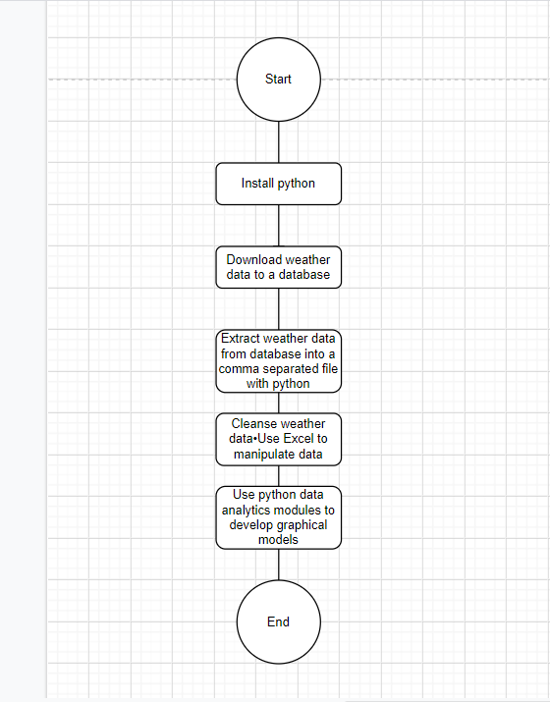
Flowchart
Include the following processes:
Install python
Download weather data to a database.
Extract weather data from database into a comma separated file with python
Cleanse weather data
Use Excel to manipulate data
Use python data analytics modules to develop graphical models

Slide 4
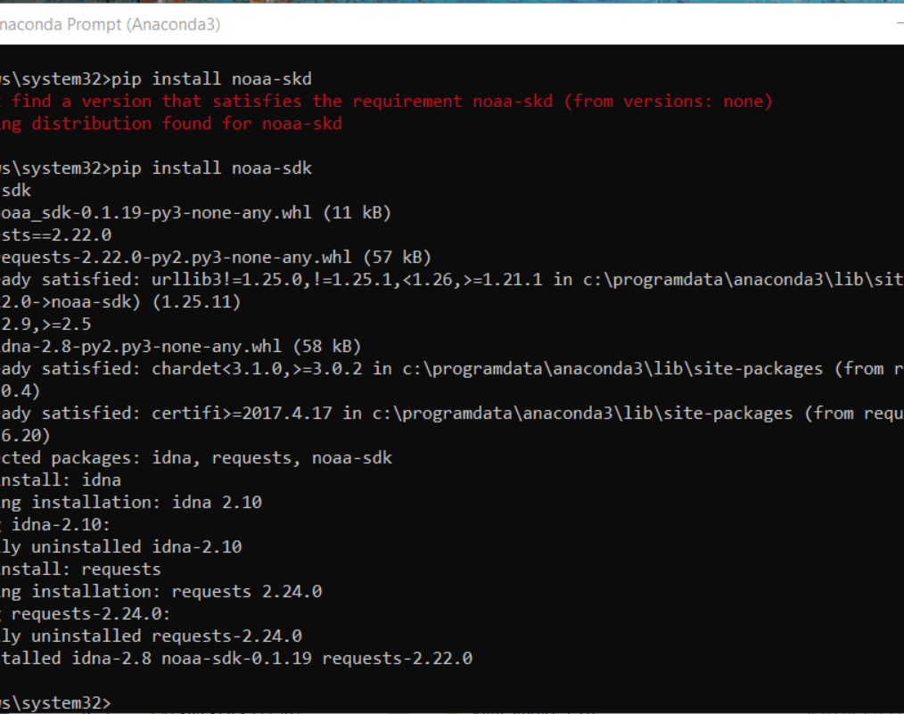
Software Inventory (Screenshots)
Include screenshot of NOAA-SDK library installed
Ensure result "Successfully installed noaa-sdk" of pip install command is visible in your screenshot.

